Slide 1

Streaming Analytics & CEP Two sides of the same coin?
Fabian Hueske
fhueske@apache.org
@fhueske
Till Rohrmann
trohrmann@apache.org
@stsffap

Slide 2
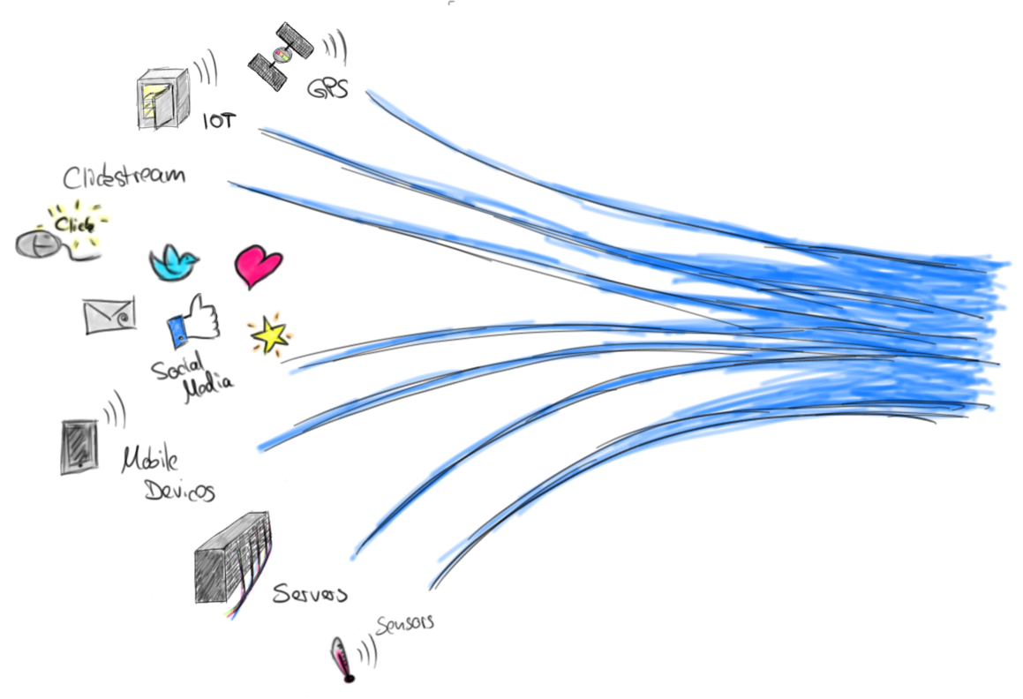
Streams are Everywhere
Most data is continuously produced as stream
Processing data as it arrives is becoming very popular
Many diverse applications and use cases

Slide 3
Complex Event Processing
Analyzing a stream of events and drawing conclusions
Detect patterns and assemble new events
Applications
Network intrusion
Process monitoring
Algorithmic trading
Demanding requirements on stream processor
Low latency!
Exactly-once semantics & event-time support

Slide 4
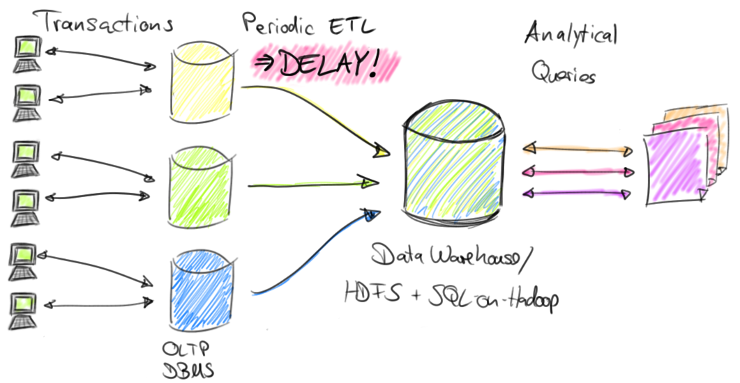
Batch Analytics
The batch approach to data analytics

Slide 5
Streaming Analytics
Online aggregation of streams
No delay – Continuous results
Stream analytics subsumes batch analytics
Batch is a finite stream
Demanding requirements on stream processor
High throughput
Exactly-once semantics
Event-time & advanced window support

Slide 6
Apache Flink®
Platform for scalable stream processing
Meets requirements of CEP and stream analytics
Low latency and high throughput
Exactly-once semantics
Event-time & advanced windowing
Core DataStream API available for Java & Scala

Slide 7
This Talk is About
Flink’s new APIs for CEP and Stream Analytics
DSL to define CEP patterns and actions
Stream SQL to define queries on streams
Integration of CEP and Stream SQL
Early stage → Work in progress

Slide 8
Tracking an Order Process
Use Case

Slide 9
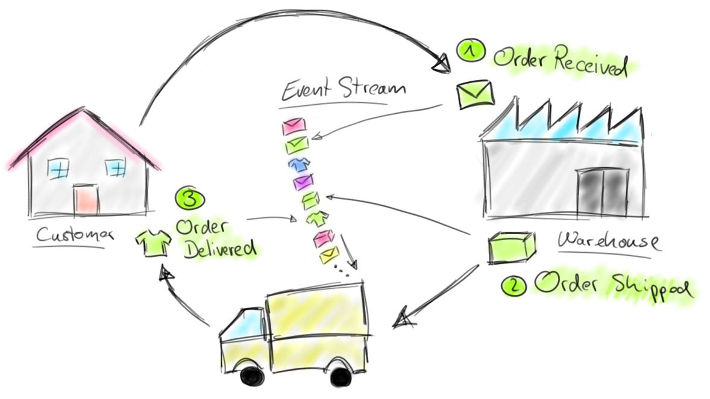
Order Fulfillment Scenario

Slide 10
Order Events
Process is reflected in a stream of order events
Order(orderId, tStamp, “received”)
Shipment(orderId, tStamp, “shipped”)
Delivery(orderId, tStamp, “delivered”)
orderId: Identifies the order
tStamp: Time at which the event happened

Slide 11
Aggregating Massive Streams
Stream Analytics

Slide 12
Stream Analytics
Traditional batch analytics
Repeated queries on finite and changing data sets
Queries join and aggregate large data sets
Stream analytics
“Standing” query produces continuous results from infinite input stream
Query computes aggregates on high-volume streams
How to compute aggregates on infinite streams?

Slide 13
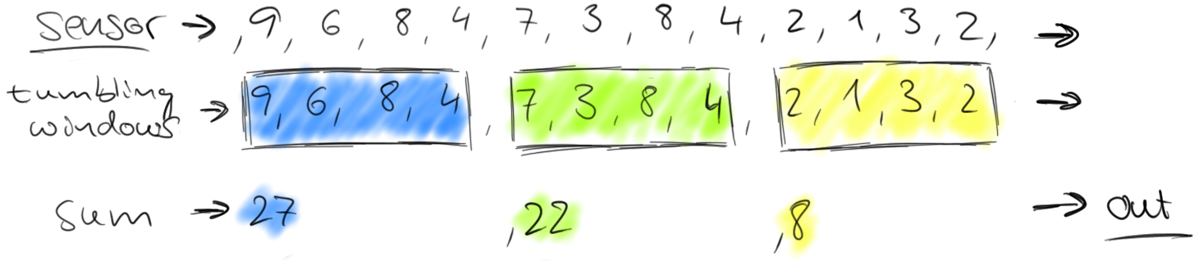
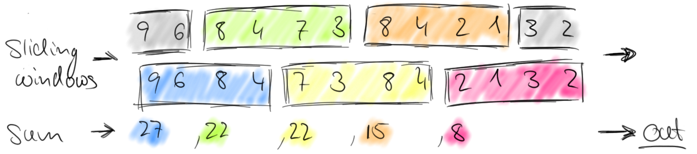
Compute Aggregates on Streams
Split infinite stream into finite “windows”
Split usually by time
Tumbling windows
Fixed size & consecutive
Sliding windows
Fixed size & may overlap
Event time mandatory for correct & consistent results!

Slide 14
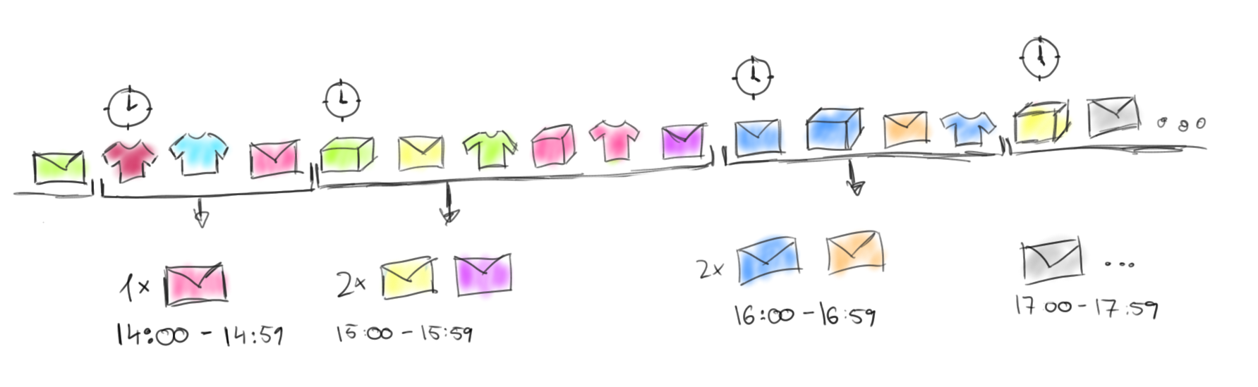
Example: Count Orders by Hour

Slide 15
Example: Count Orders by Hour
SELECT STREAM
TUMBLE_START(tStamp, INTERVAL ‘1’ HOUR) AS hour,
COUNT(*) AS cnt
FROM events
WHERE
status = ‘received’
GROUP BY
TUMBLE(tStamp, INTERVAL ‘1’ HOUR)

Slide 16
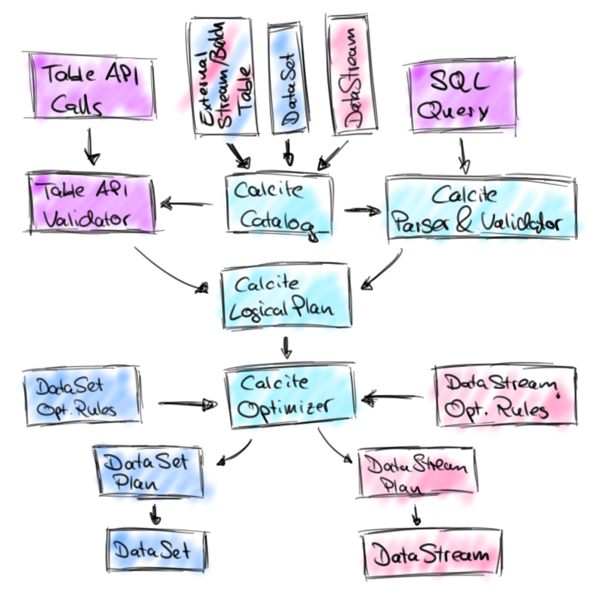
Stream SQL Architecture
Flink features SQL on static and streaming tables
Parsing and optimization by Apache Calcite
SQL queries are translated into native Flink programs

Slide 17
Pattern Matching on Streams
Complex Event Processing

Slide 18
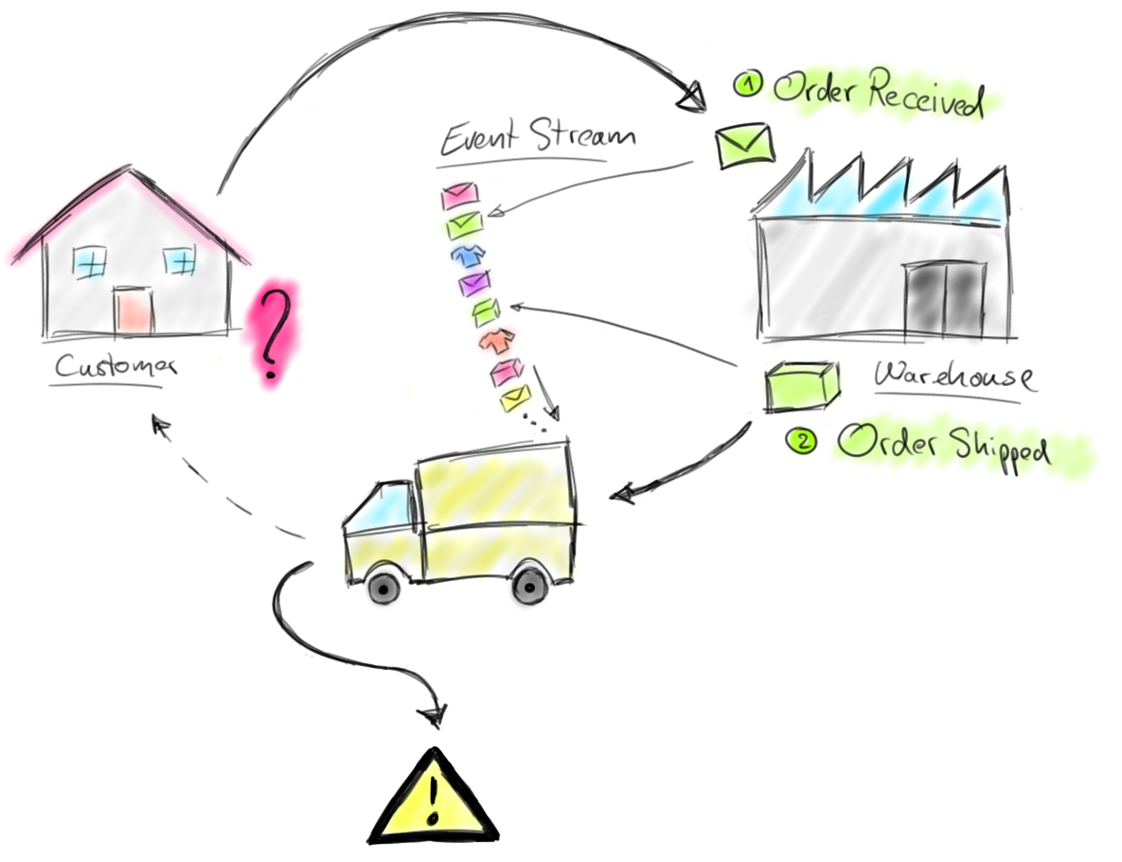
Real-time Warnings

Slide 19
CEP to the Rescue
Define processing and delivery intervals (SLAs)
ProcessSucc(orderId, tStamp, duration)
ProcessWarn(orderId, tStamp)
DeliverySucc(orderId, tStamp, duration)
DeliveryWarn(orderId, tStamp)
orderId: Identifies the order
tStamp: Time when the event happened
duration: Duration of the processing/delivery

Slide 20
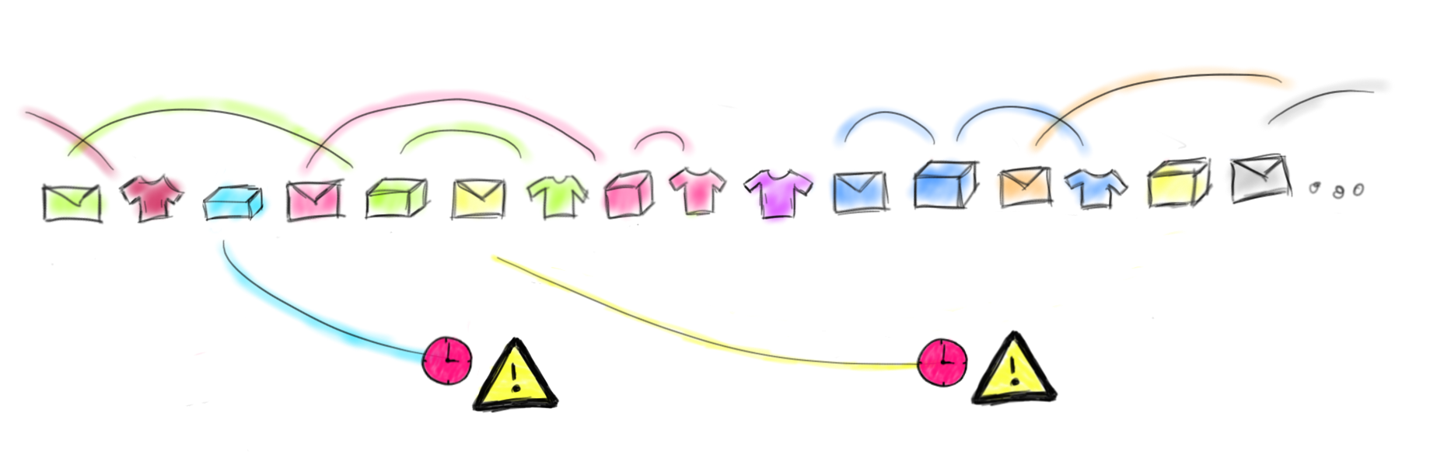
CEP Example

Slide 21
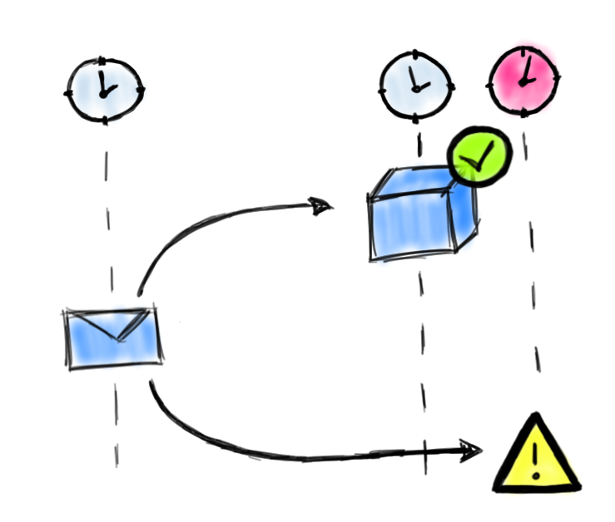
Processing: Order → Shipment
val processingPattern = Pattern
.begin[Event]("received").subtype(classOf[Order])
.followedBy("shipped").where(_.status == "shipped")
.within(Time.hours(1))
val processingPatternStream = CEP.pattern(
input.keyBy("orderId"),
processingPattern)
val procResult: DataStream[Either[ProcessWarn, ProcessSucc]] =
processingPatternStream.select {
(pP, timestamp) => // Timeout handler
ProcessWarn(pP("received").orderId, timestamp)
} {
fP => // Select function
ProcessSucc(
fP("received").orderId, fP("shipped").tStamp,
fP("shipped").tStamp – fP("received").tStamp)
}

Slide 22
… and both at the same time!
Integrated Stream Analytics with CEP

Slide 23
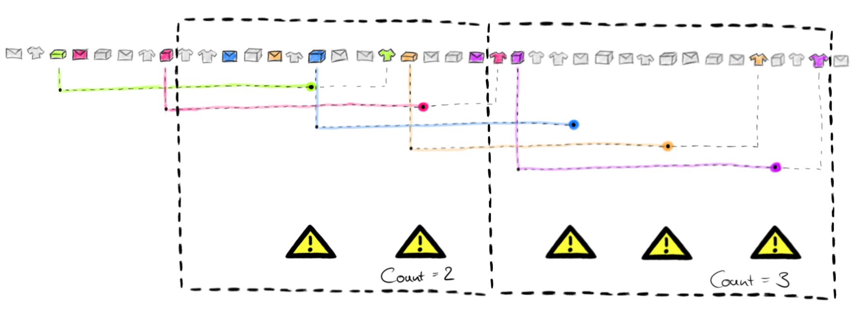
Count Delayed Shipments

Slide 24
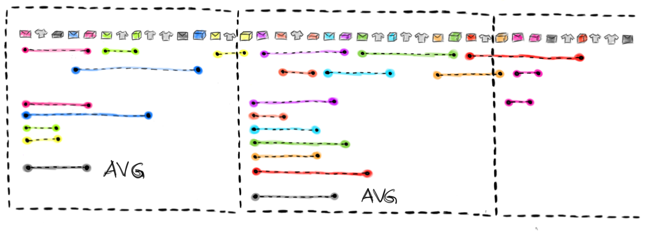
Compute Avg Processing Time

Slide 25
CEP + Stream SQL
// complex event processing result
val delResult: DataStream[Either[DeliveryWarn, DeliverySucc]] = …
val delWarn: DataStream[DeliveryWarn] = delResult.flatMap(_.left.toOption)
val deliveryWarningTable: Table = delWarn.toTable(tableEnv)
tableEnv.registerTable(”deliveryWarnings”, deliveryWarningTable)
// calculate the delayed deliveries per day
val delayedDeliveriesPerDay = tableEnv.sql(
"""SELECT STREAM
| TUMBLE_START(tStamp, INTERVAL ‘1’ DAY) AS day,
| COUNT(*) AS cnt
|FROM deliveryWarnings
|GROUP BY TUMBLE(tStamp, INTERVAL ‘1’ DAY)""".stripMargin)

Slide 26
CEP-enriched Stream SQL
SELECT
TUMBLE_START(tStamp, INTERVAL '1' DAY) as day,
AVG(duration) as avgDuration
FROM (
// CEP pattern
SELECT (b.tStamp - a.tStamp) as duration, b.tStamp as tStamp
FROM inputs
PATTERN
a FOLLOW BY b PARTITION BY orderId ORDER BY tStamp
WITHIN INTERVAL '1’ HOUR
WHERE
a.status = ‘received’ AND b.status = ‘shipped’
)
GROUP BY
TUMBLE(tStamp, INTERVAL '1’ DAY)

Slide 27
Conclusion
Apache Flink handles CEP and analytical workloads
Apache Flink offers intuitive APIs
New class of applications by CEP and Stream SQL integration ☺

